Slide 1
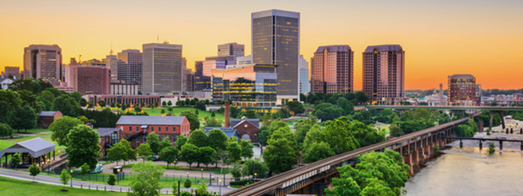
Business Opportunities Exploration of Richmond, Virginia
A Data Science Project by James M. Comstock
September 2020
Notes:
http://www.richmondgov.com/

Slide 2
Contents
Introduction
Data
Methods
Results
Discussion
Conclusion

Slide 3
Introduction
Richmond, Virginia, is a mid-size American city of approximately 230,000 people.
After decades of stagnation, Richmond has enjoyed economic and cultural renewal in recent years.
In 2019, Trailblazer Magazine showcased the “revolution” in Richmond, highlighting the success of the dining scene, craft breweries, industry, and the arts (http://trailblazermagazine.net/2019/06/richmond-revolution/)
Central question: Where might investors and entrepreneurs find opportunities in this environment?
Preliminary finding: Market research, using venue information and aggregate income data, illustrates a city with business diversity and room for growth.
Notes:
http://trailblazermagazine.net/2019/06/richmond-revolution/

Slide 4
Data
Foursquare API: The Foursquare web application provided detailed information on all businesses within the city limits of Richmond.
Internal Revenue Service 2017 Virginia Income Data: Aggregated income tax data from the United States Internal Revenue Service provided a zip code-level view of residents’ personal income. This information enabled a deeper understanding of each zip code, as it provided some context on how well the residents of each area are doing financially.
City of Richmond Neighborhood Parcels: Property data from the City provided information on which neighborhoods were in each zip code, as well as the planning districts in which each neighborhood resides.

Slide 5
Methodology
Data Acquisition & First Cleaning: Step one was establishing the neighborhood zip code and location data. This entailed extraction of zip codes and neighborhoods from City data. A parallel effort yielded the 2017 income tax data by zip code for Virginia. The income information required aggregation of total gross taxable income in each zip code, extracted from a much larger data set.
Initial Exploration: Creating a Folium map of neighborhoods provided a first glimpse of the distribution of neighborhoods throughout the city.
Mining Foursquare: Extraction of business venues in the City of Richmond enabled the creation of a data frame with all of the City’s businesses.
Cleaning and Initial Analysis of Venues:
Grouping of venues by neighborhood provided the means to see all of the businesses in any given neighborhood within the City.
Sorting the top ten venues by neighborhood illustrated the prevalence of business types in each neighborhood. This provided the raw material for machine learning.
Clustering: Application of the K-means clustering algorithm divided city into 5 clusters.
Visualization: Creating a Folium map visualization of clusters showed the layout of clusters within the City.
Case study example: Exploration of “Pizza Places” identified the distribution of pizza parlor locations across the City and areas for potential growth.

Slide 6
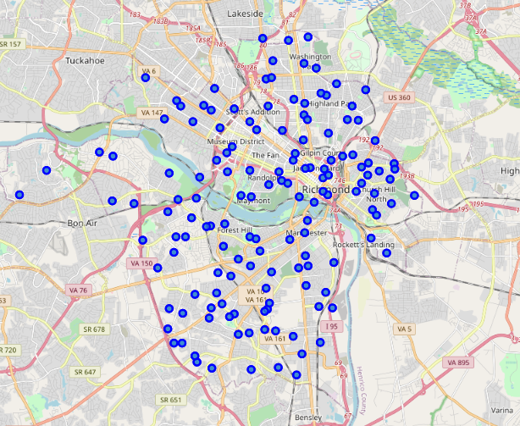
Mapping Neighborhoods of Richmond
City data denoted 148 neighborhoods.
The Folium mapping package enabled the creation of this and all subsequent maps.
Visualizing the neighborhoods shows a generally tighter concentration in the city center and wider distribution as you go further south and west.

Slide 7
Analysis of Zip Codes and Venues
Combining the relevant data into a synthesized whole produced a snapshot of the business and geographical landscape:
13 zip codes
148 neighborhoods, 135 with business venues
1200+ venues
220+ venue categories
Notes:
135 neighborhoods after merge, meaning 13 without venues

Slide 8
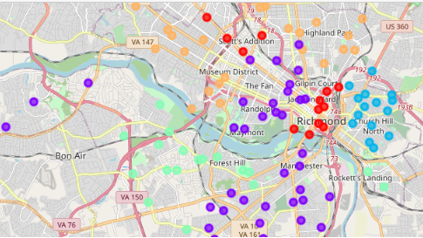
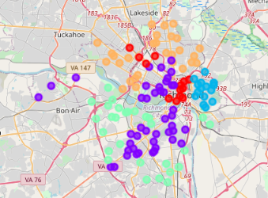
Clustering Neighborhoods Using K-means
Grouping venues by neighborhood and sorting the top ten venue categories in each neighborhood provided the relevant content to analyze each neighborhood. Subsequent use of one-hot encoding provided the numerical data points for machine learning.
K-means clustering analysis yielded 5 clusters.
Use of algorithm with and without income data yielded the exact same results, demonstrating that income data itself was not a determining factor.

Slide 9
Zooming in: Cluster 1 Neighborhoods
Viewing Cluster 1 shows some commonalities among the Top 5 Most Common Venues.
Notably, Cluster 1 neighborhoods appear to be defined by construction and landscaping, fitness businesses, specialty restaurants and retail, and middle-high income, in broad terms.

Slide 10
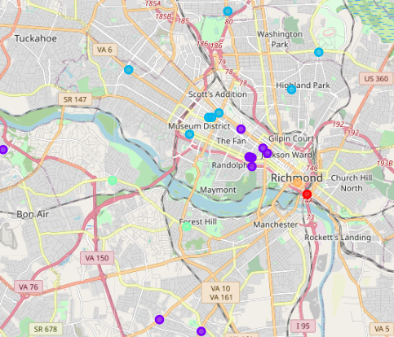
Deep Dive: Analysis of Pizza Places
Pizza restaurants, or parlors, are a common feature of the American food service industry and provide a narrow focus for further analysis.
Extracting pizza venues from the assembled data yielded some interesting observations.
The distribution of parlors throughout the city varies greatly and does not correspond with income.
Concentrations:
Linearly, there is a large concentration along the Monument Avenue corridor
In terms of proximity, there are distinct clusters around the Museum District and southeast end of The Fan

Slide 11
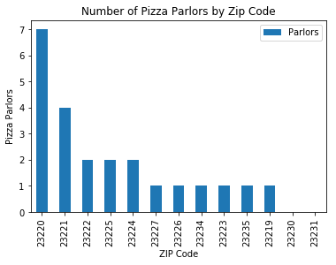
Deep Dive: Analysis of Pizza Places
23 pizza places
11 of 13 zip codes have parlors
Of two without parlors, one has high income and the other is low income. Income is shown in $1000s.

Slide 12
Discussion
Exploratory analysis indicates a diverse business environment.
Examining the results of venue analysis, there are characteristics that uniquely define the 5 clusters of city neighborhoods.
For an investor or entrepreneur, there are at least two general methods to select a location for a new venture:
With a business category already in mind, select neighborhood based on the absence or near absence of comparable businesses.
Select location based on a combination of income level and relative absence of desired business type.
The pizza parlor case study provides multiple avenues for investment:
While some areas are oversaturated, two zip codes have no pizza parlors.
High income areas are ripe for development of a boutique parlor venue.
For a supply vendor, targeting the parlors by location and/or zip code income could enable either high volume or specialized partnership.

Slide 13
Conclusion
Richmond has a diverse business community and is ripe for continued investment.
Higher income neighborhoods are ripe for targeted investment opportunities, depending on zoning.
A case study of pizza parlors alone highlighted multiple avenues for entrepreneurism.
Overall, this research demonstrates the potential for a local investor or entrepreneur to utilize data analysis of the market to make well-informed decisions.

Slide 14
Sources
Foursquare API. www.Foursquare.com
Parcel Geographic Summary: City of Richmond Data Portal. Accessed May 18, 2020. Available at https://data.richmondgov.com/browse?category=Unique+and+Inclusive+Neighborhoods
2017 Virginia Income data. Internal Revenue Service. Accessed May 20, 2020. Available at https://www.irs.gov/statistics/soi-tax-stats-individual-income-tax-statistics-2017-zip-code-data-soi
Cover image from richmondgov.com

